Slide 1
Chapter 3: Introduction to SQL

Slide 2
Outline
Overview of The SQL Query Language
SQL Data Definition
Basic Query Structure of SQL Queries
Additional Basic Operations
Set Operations
Null Values
Aggregate Functions
Nested Subqueries
Modification of the Database
Notes:
1

Slide 3
Aggregate Functions
These functions operate on the multiset of values of a column of a relation, and return a value
avg: average value min: minimum value max: maximum value sum: sum of values count: number of values

Slide 4
Aggregate Functions Examples
Find the average salary of instructors in the Computer Science department
select avg (salary) from instructor where dept_name= 'Comp. Sci.';
Find the total number of instructors who teach a course in the Spring 2018 semester
select count (distinct ID) from teaches where semester = 'Spring' and year = 2018;
Find the number of tuples in the course relation
select count (*) from course;

Slide 5
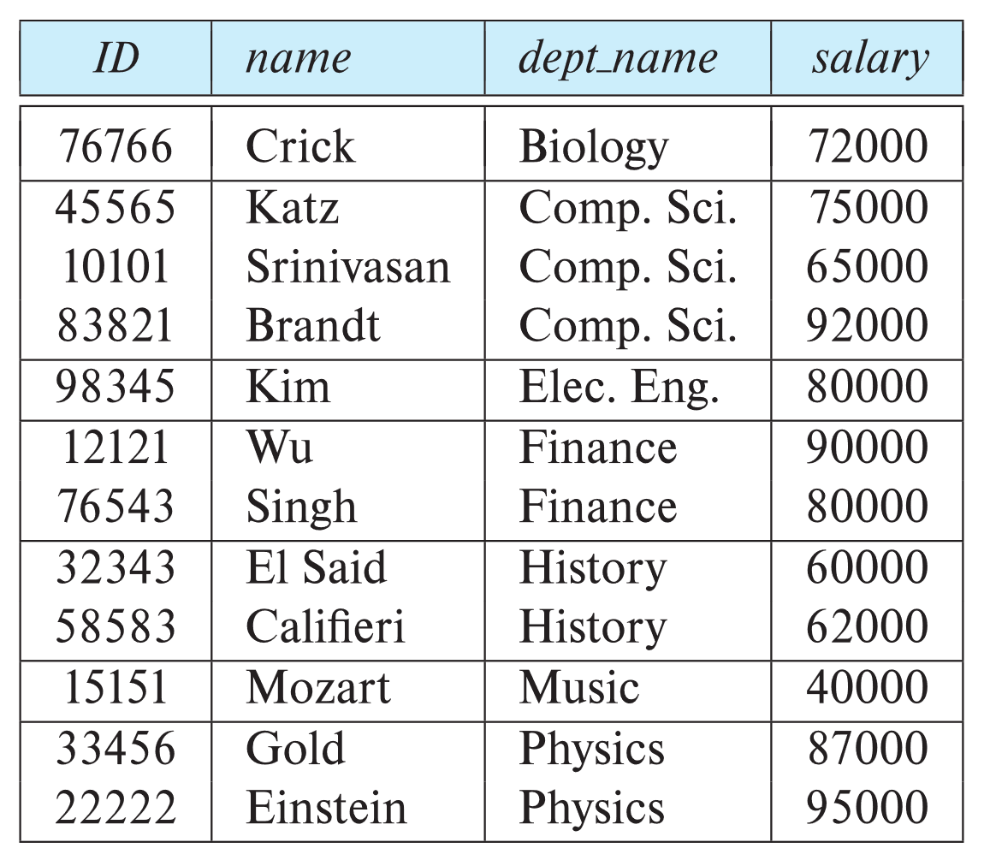
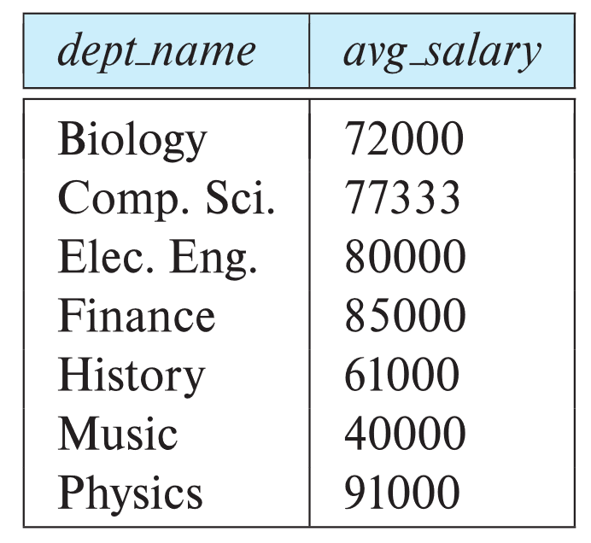
Aggregate Functions – Group By
Find the average salary of instructors in each department
select dept_name, avg (salary) as avg_salary from instructor group by dept_name;

Slide 6
Aggregation (Cont.)
Attributes in select clause outside of aggregate functions must appear in group by list
/* erroneous query */ select dept_name, ID, avg (salary) from instructor group by dept_name;

Slide 7
Aggregate Functions – Having Clause
Find the names and average salaries of all departments whose average salary is greater than 42000
Note: predicates in the having clause are applied after the formation of groups whereas predicates in the where clause are applied before forming groups
select dept_name, avg (salary) as avg_salary
from instructor
group by dept_name
having avg (salary) > 42000;

Slide 8
Null Values and Aggregates
Total all salaries
select sum (salary ) from instructor
Above statement ignores null amounts
Result is null if there is no non-null amount
All aggregate operations except count(*) ignore tuples with null values on the aggregated attributes
What if collection has only null values?
count returns 0
all other aggregates return null

